Slide 1

JS Outside the Browser
npm

Slide 2
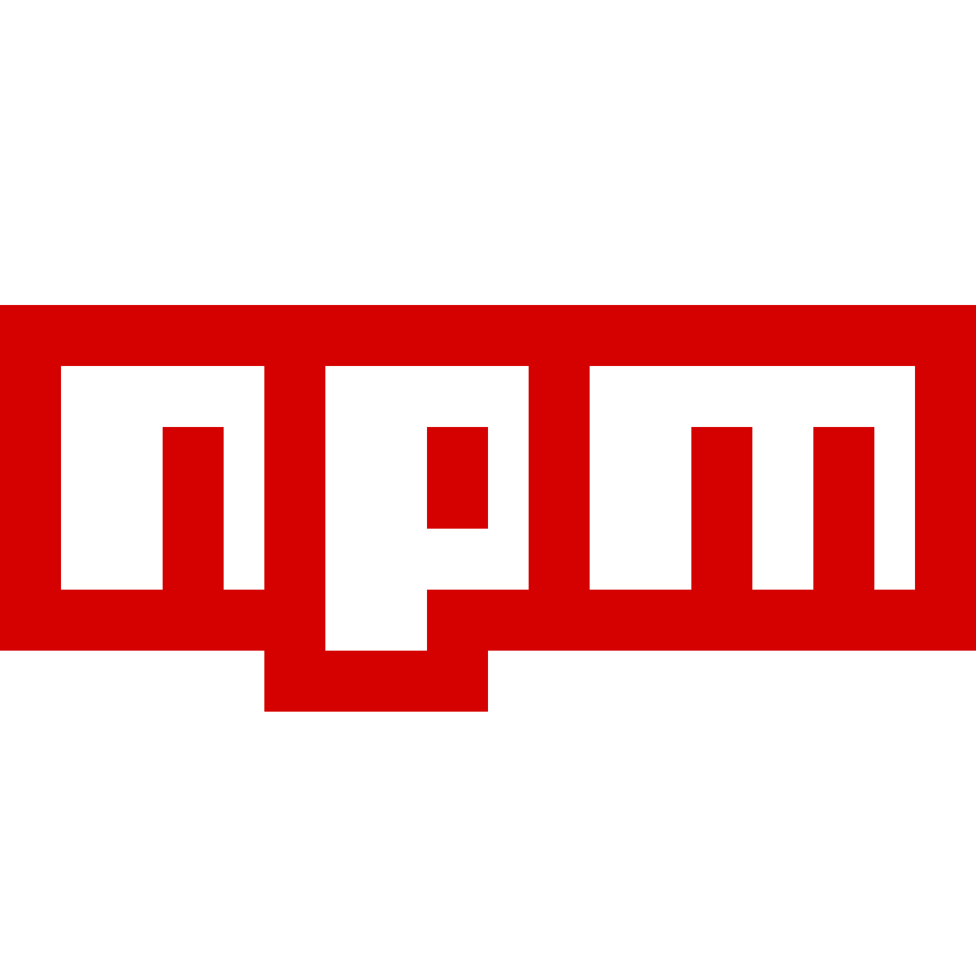
Node Package Manager
Prepare, install, and publish NodeJS packages
Runs build scripts

Slide 3
package.json
Info about the NodeJS package
name
version
main entry point
dependencies
npm uses it to:
install dependencies
run scripts
publish

Slide 4
semver
Patch Version
Bugfixes
Does not add functionality
"version": "10.8.3"
Major Version
Changes API
Not backwards-compatible
Minor Version
Adds features or changes functionality
Is backwards-compatible

Slide 5
Summary
Use npm to install dependencies, run scripts, and publish packages
How to create package.json files
node_modules and package-lock.json
Including dependencies via require()

Slide 6
Next Up
Webpack

